Slide 1
Gender and Media Studies

Slide 2
Table of Contents
Representation of male/female avatars
VG culture’s (inexplicable) hostility towards women
Positive examples of avatars: are things getting better? (I think yes…slowly…)
Character customization and player motivation

Slide 3
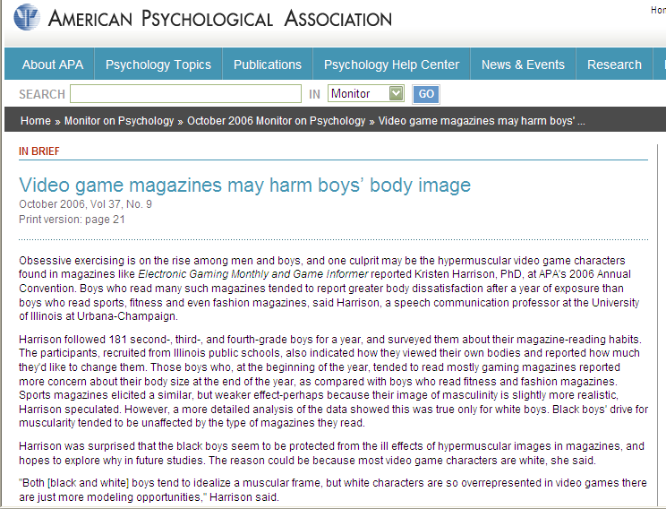
Regarding boys….

Slide 4
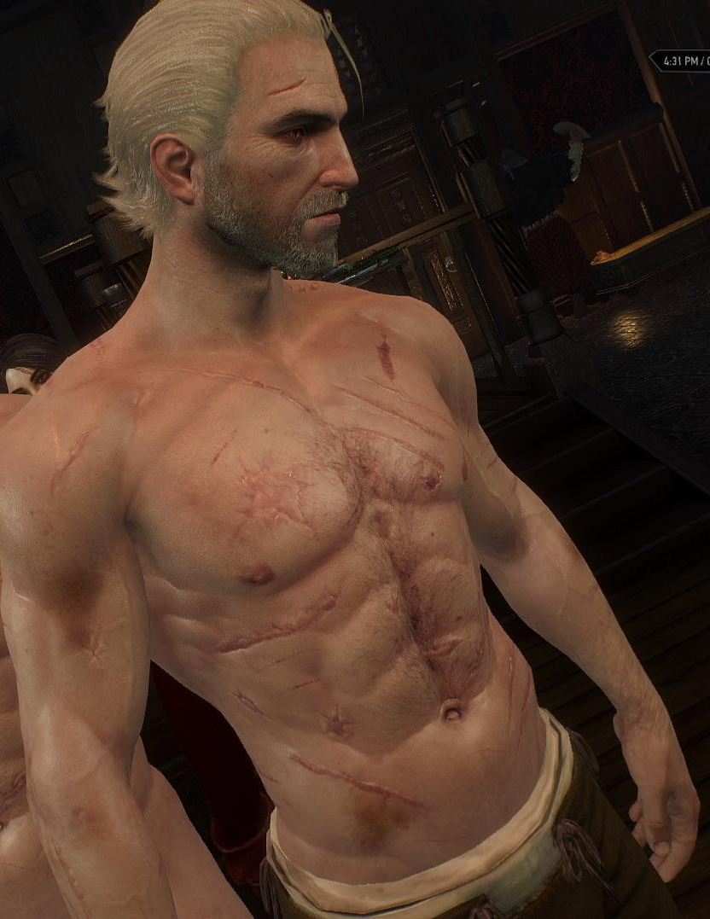
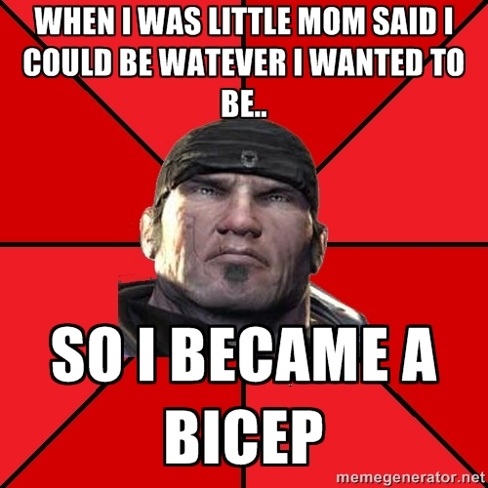
Yes, many male avatars are physical power fantasies

Slide 5
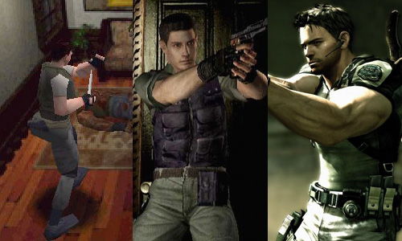
Some would call the evolution of Chris Redfield’s biceps in the Resident Evil Franchise “fantasy” and “entertainment.” Other would called it “unnecessary.”

Slide 6
Men have it bad; Women have it Worse
A large portion of video game players harass and disrespect women.
Video games and video game marketing materials are predominantly sexist and discriminatory towards women.
The representations of women’s roles and body types featured in video games is often very limited.
This narrow range of representation alienates a large proportion of female gamers.
Gaming Community: We Need to Talk (Again) | D. A. White

Slide 7

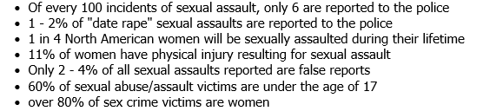
Brock Turner (2016)
It’s a lot easier to abuse someone when you see them as an “object” as opposed to a person.
Statistics don’t lie:
Raped an unconscious girl behind a dumpster. Convicted. Served 3 months. Never really admitted guilt.
THIS IS THE WORLD IN WHICH YOUR GAMES EXIST

Slide 8
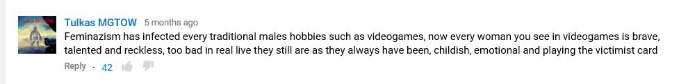
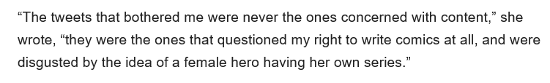
Why are women “excluded” and deemed unwelcome from VG culture?

Slide 9
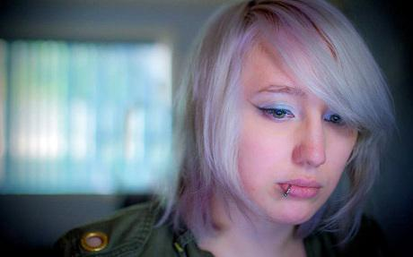
#GAMERGATE
2014 “movement” allegedly about transparency in gaming journalism; Instead, operated more like targeted harassment against females who spoke out about the industry’s double standards.
5 Things I Learned as the Internet's Most Hated Person | Cracked.com
The Cankerous Slime-Slick Shame Pit That Is #GamerGate « terribleminds: chuck wendig
Zoe Quinn—game developer.
Another Woman In Gaming Flees Home Following Death Threats

Slide 10
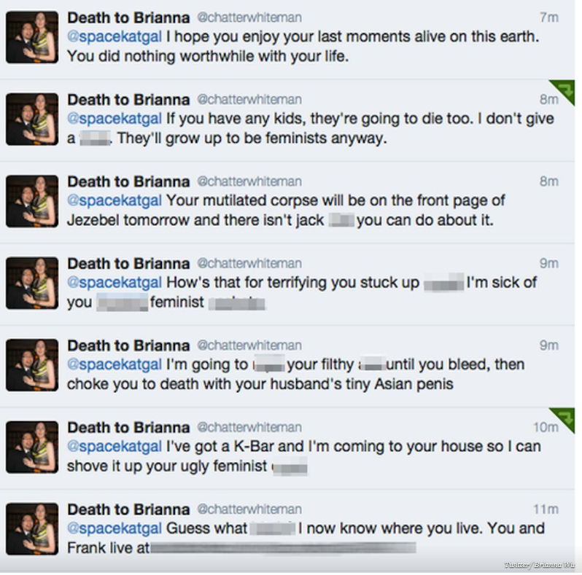
Please note, all the targets are women with very little power or visibility (indie game devlopers and youtube personalities). Gamergate doesn’t seem to attack big publishers or organizations with the same zest. Or, attack, you know, people and organizations that actually deserve it: ISIS, Monsanto, the Koch Brothers, etc, etc…
Death Threats to video game designer Brianna Wu

Slide 11
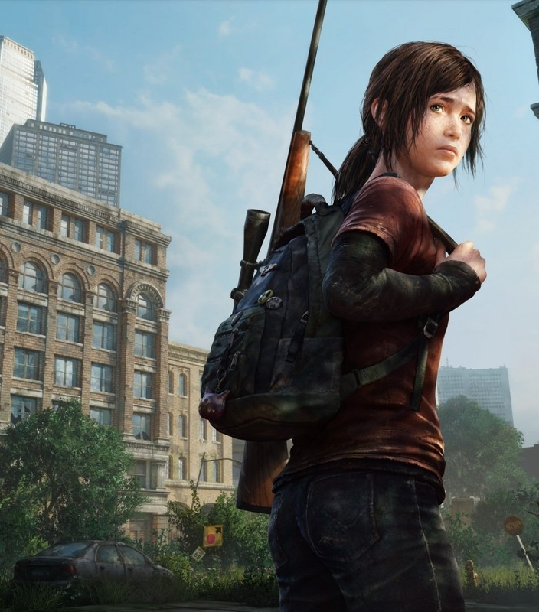
Representation: Two Parts
Visibility: How often do females appear in video games?
Character: When women are present, how are they portrayed? As complex “normal” characters or shallow stereotypes and/or eye candy.

Slide 12
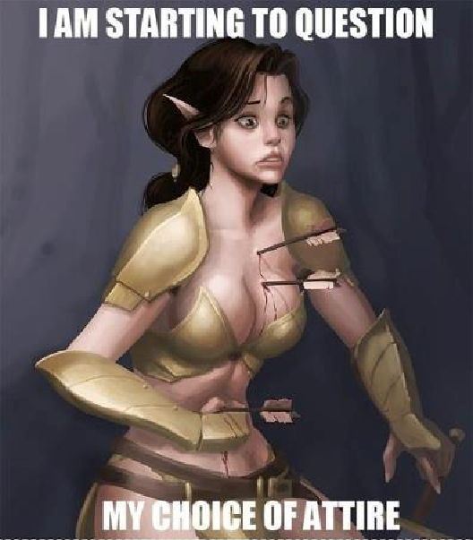
Shallow Female Characterization
Most male video game protagonists (even the sexualized ones) usually have complex motivations and back stories.
Conversely, most female characters are hyper-sexualized, and their bodily dimensions become the central defining aspect of their characters.

Slide 13
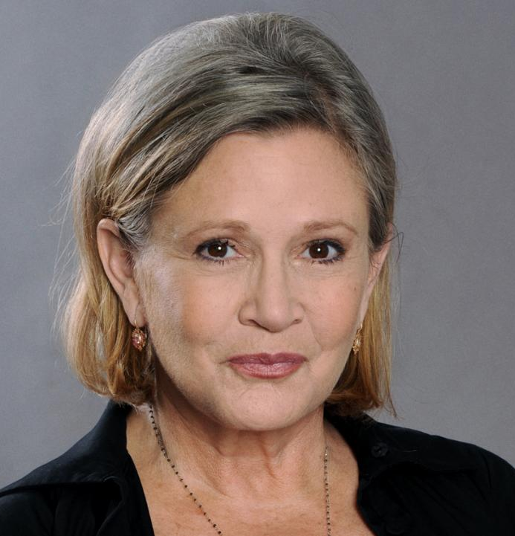
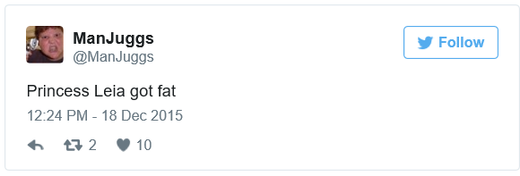
Yeah, but isn’t being “hot,” like empowering, and stuff?
Well, it is until it isn’t.
Being respected/valued for being intelligent, ingenious, and creative is more meaningful than being valued simply for being beautiful.
Beauty fades. Being valued merely for being beautiful is a shallow, fleeting form of empowerment.
“Youth and beauty aren’t accomplishments” Carrie Fisher

Slide 14
What Games do Females Prefer?
Main protagonist isn’t gendered (ie: animal/creature)
Games that promote interpretation/creativity (as opposed to sports or violent combat focused games)
Thus, The Sims has been hailed as a game that appeals strongly to females because its…

Slide 15
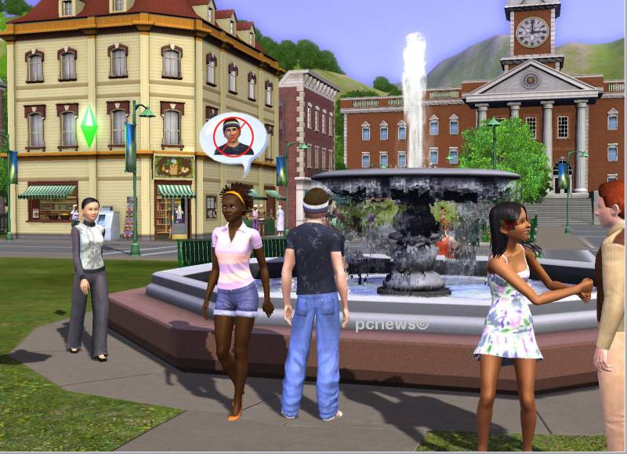

Characters are everyday people
Goal is to explore and have new experiences
Play focuses on multi-sensory immersion, discovery and strong story lines
Success comes through the development of friendships

Slide 16
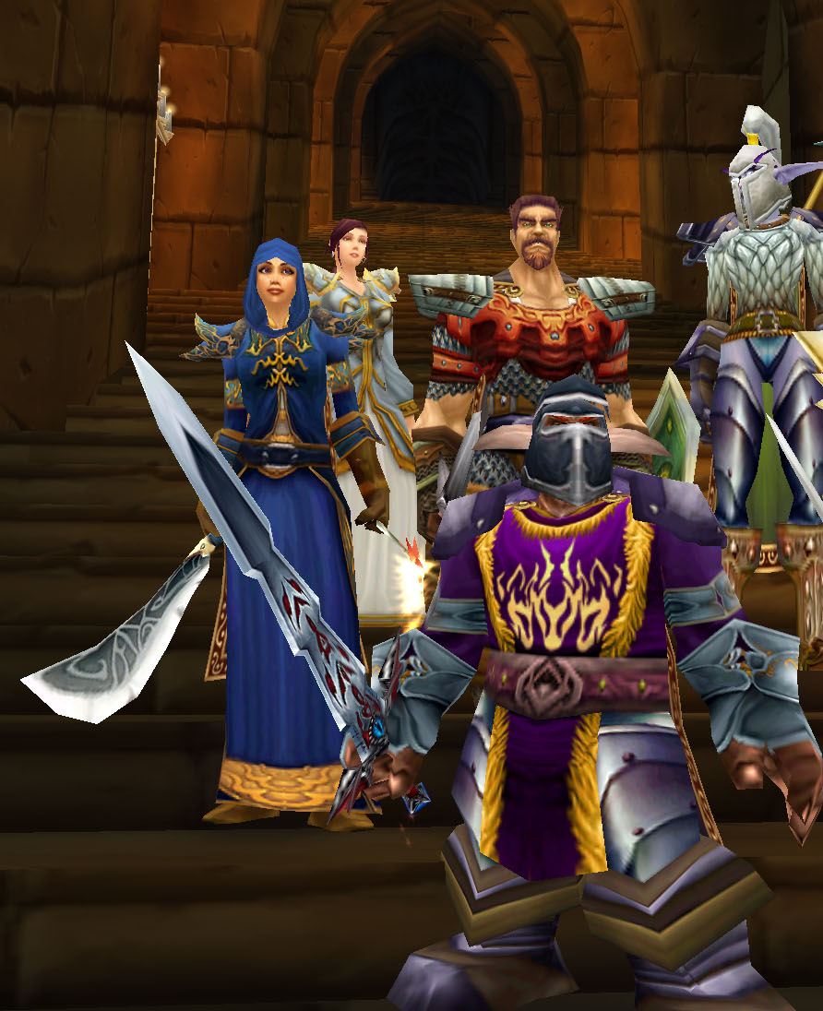
However, “games that simply focus on friendship and sociality may overlook the fact that girls are looking for games which also push them to take risks and where there is a chance to be absolutely and unequivocally dominant” (175).

Slide 17
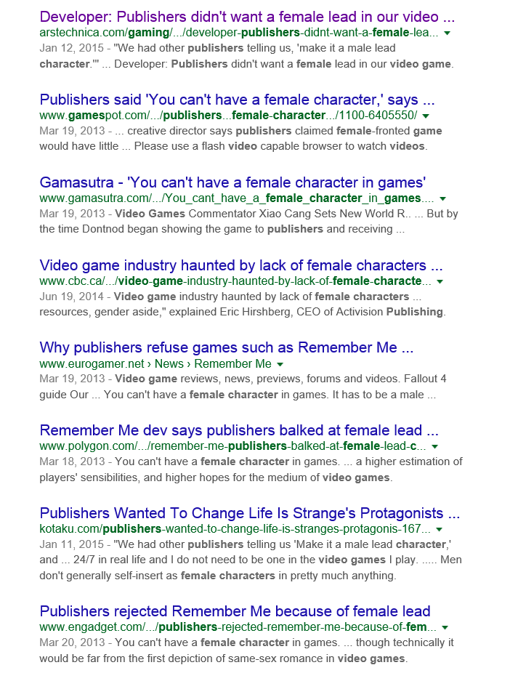
Made by Men for Men (172)
As we discovered in Week one, 43% of gamers are females.
However, most video games are designed by males, for males
In other instances, publishers outright reject games with female leads.

Slide 18

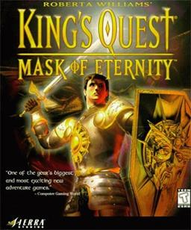


Well known Female Designers
Brenda Laurel
Roberta Williams
Brenda Laurel on games for girls | Video on TED.com

Slide 19
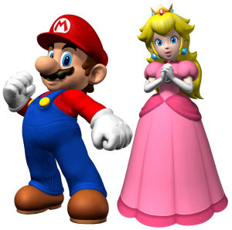
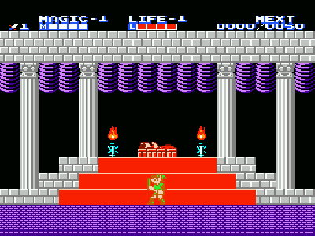
Cliché Alert: Passive Character Representation
In many games, females are depicted as passive—as characters that need saving.

Slide 20
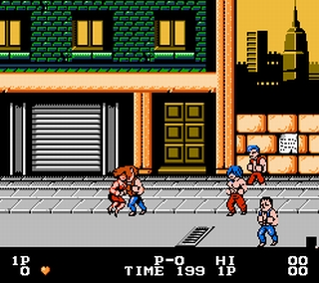
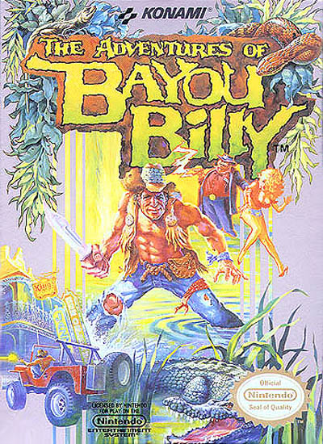
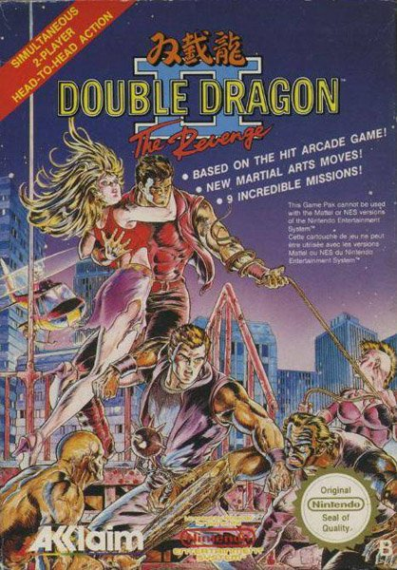
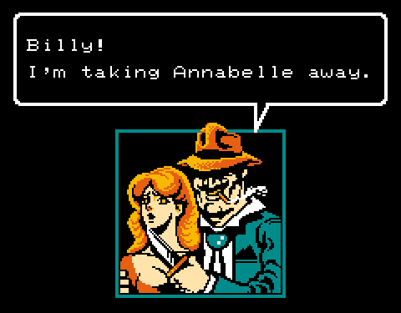

Slide 21

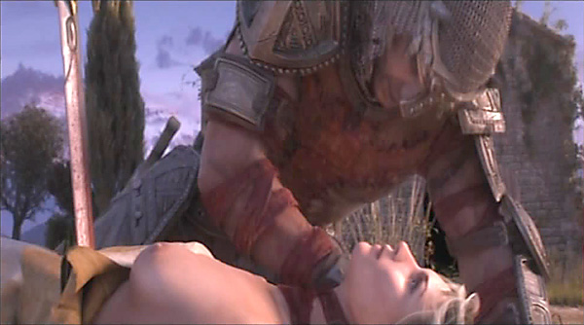
Classics professors have denounced the game Dante’s Inferno for its portrayal of Beatrice, Dante’s wife: in the original story, Beatrice saves Dante. In the game she is reduced to a victim.

Slide 22
Body Types and Poses
The predominant female body type in most video games is an exaggerated sexualized physique that is “curvaceously thin.”
Racial and ethnic representation is marginal, with main characters being predominantly white.
Consider the variety of leading male protagonists for a second…

Slide 23
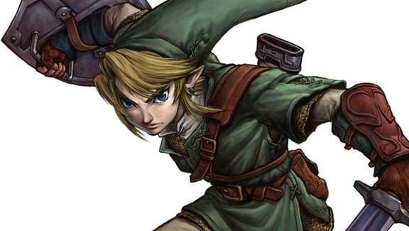
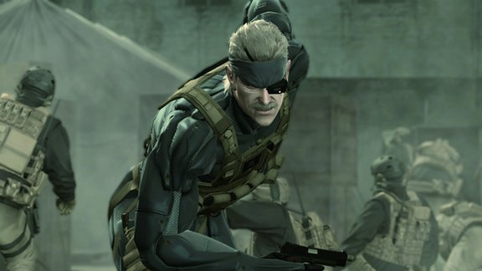
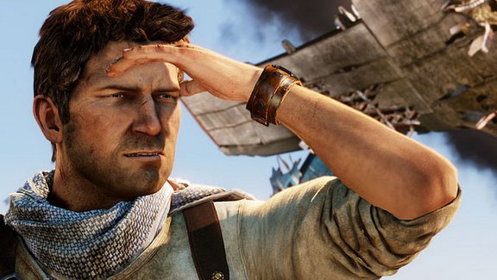
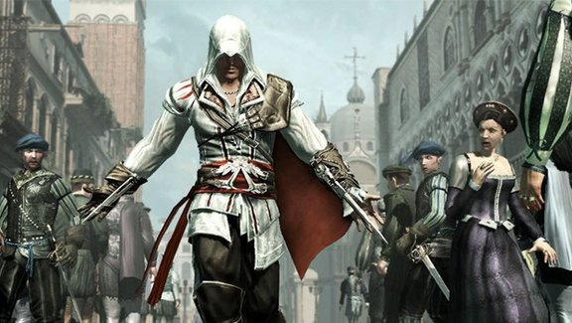
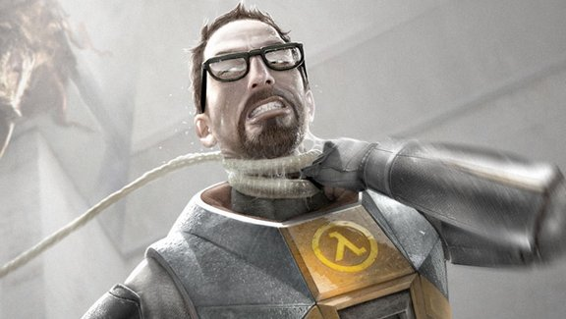
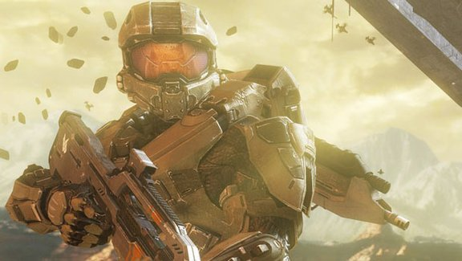

Slide 24
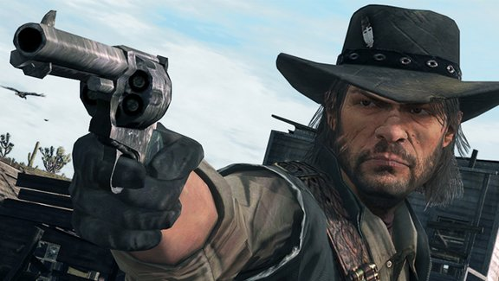
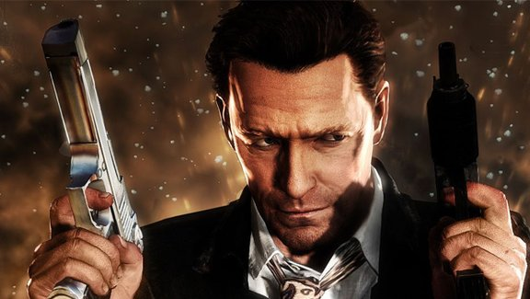
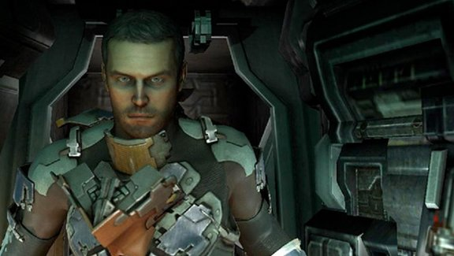
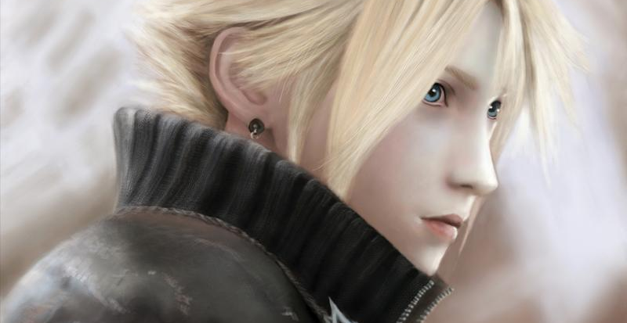
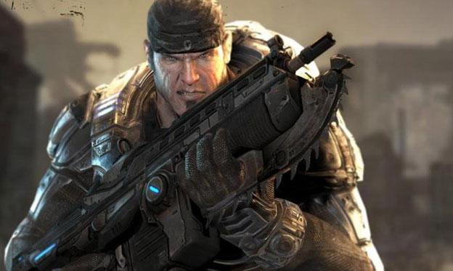
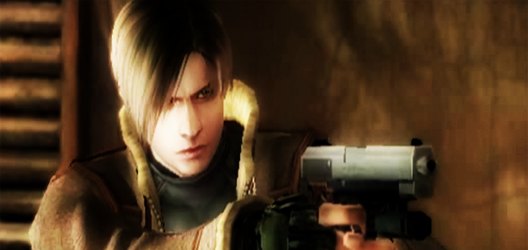

Slide 25
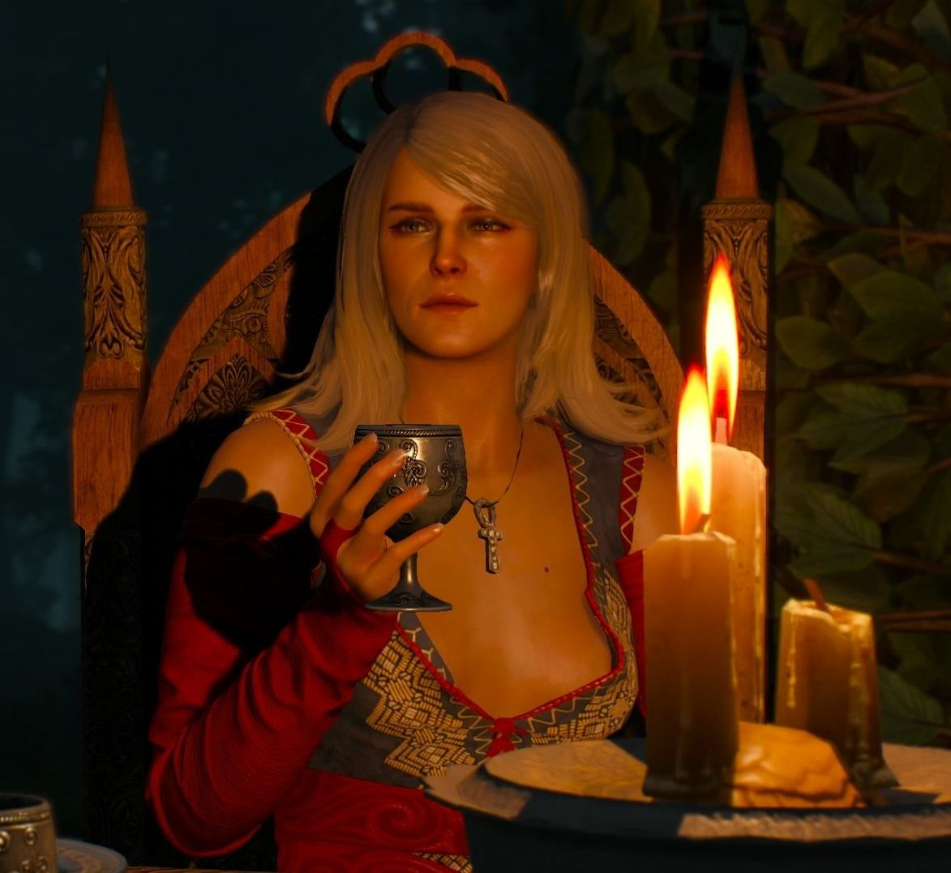
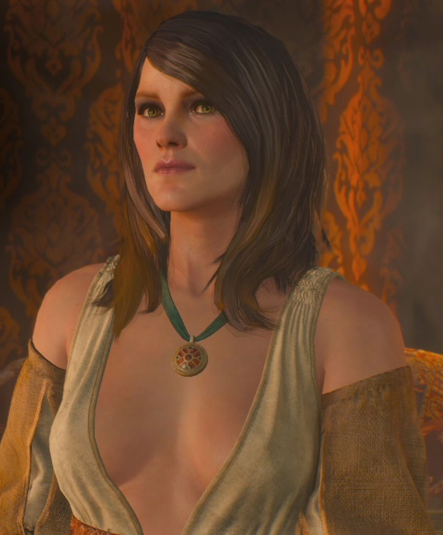
Sexuality and Agency
There is a big difference between a capable, complex female character who is in control of her sexuality (ie: Kiera Metz from Witcher 3) and the numerous NPCs in Witcher 3 wearing just ridiculously sexualized outfits (and no, I’m not talking about the “strumpets”).
The issue is not that all skin is bad; it’s a question (again) of agency and representation

Slide 26
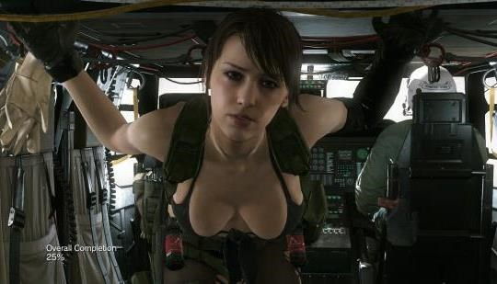
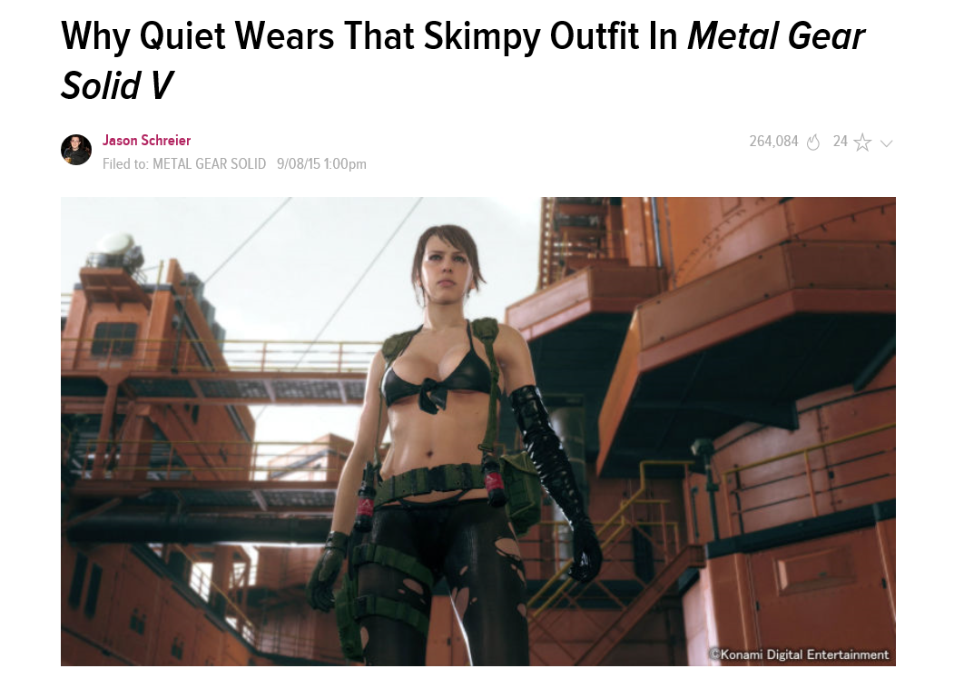
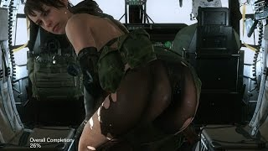
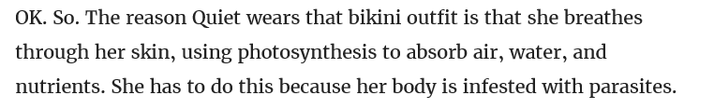
Worst. Designer. Excuse. For Female. Skin. Ever.

Slide 27
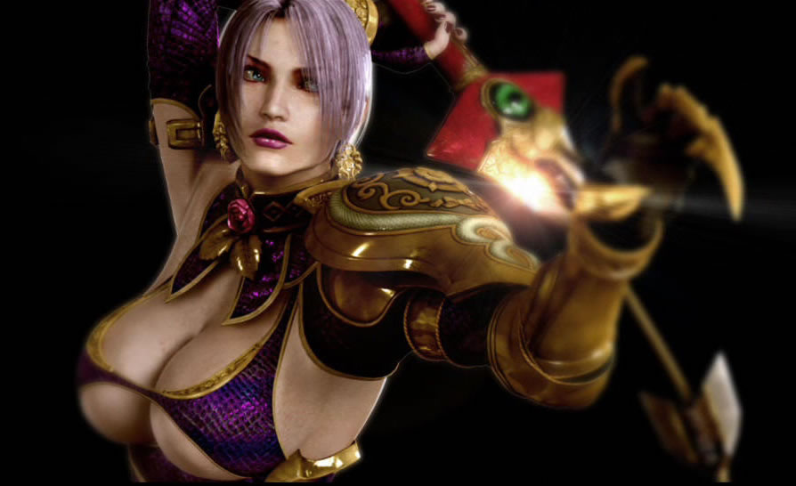
Soul Caliber 4
Often female characters are included in games to provide sexual arousal to straight male players.

Slide 28
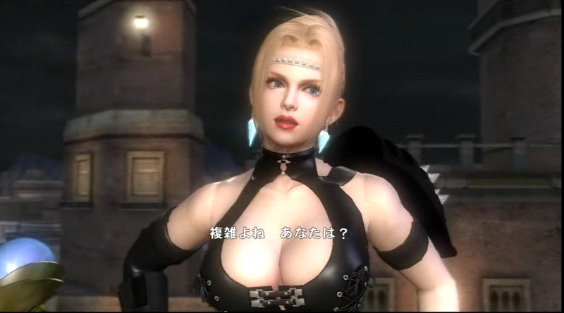
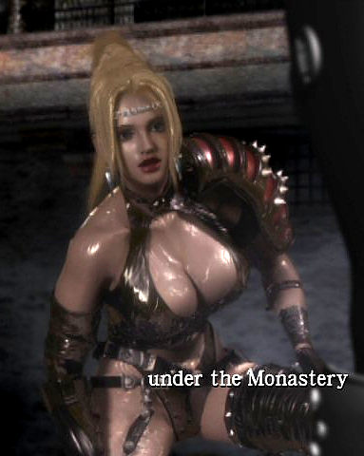
Rachel from the Ninja Gaiden Series

Slide 29
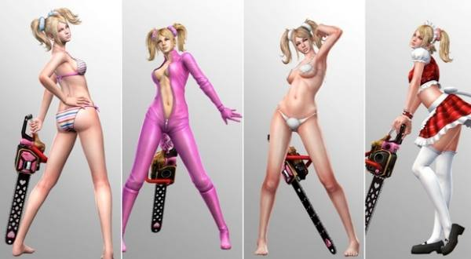
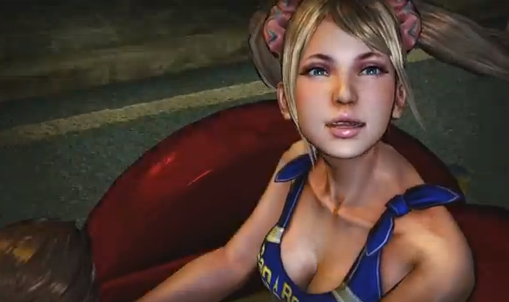
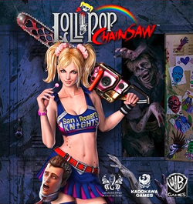
Lollipop Chainsaw

Slide 30
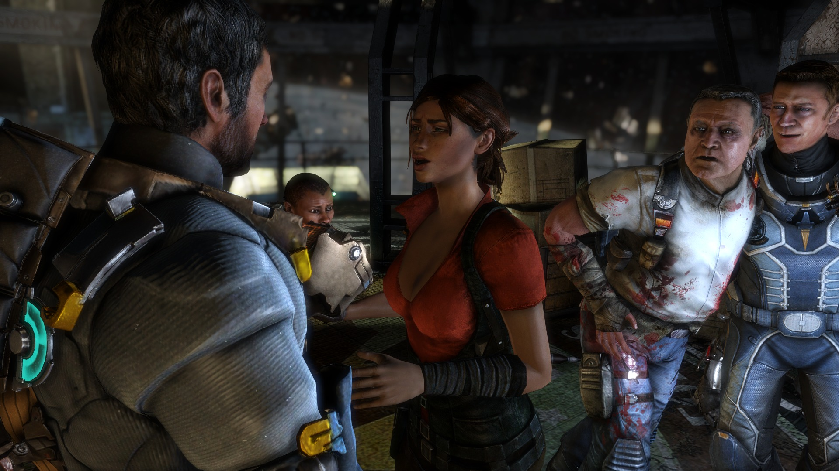
Isaac! I got a new eye and a boob job! I don’t need armour! Girl power!
Ellie from Dead Space 3: It’s cold, in the middle of space, with horrible monsters all around. The outfit just makes sense.

Slide 31
Pseudo-Representation
Yes, there are many new female protagonists in games; however, how are these females represented?
Are they of a diverse body type, skill level, race and motivation?
Or are they all scantily clad babes who are either the victims or perpetrators of violence?

Slide 32

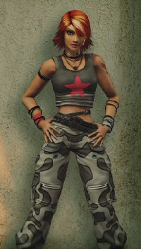


Slide 33



Slide 34


Designer by Hideki Kamiya called Bayonetta his “ideal woman.”

Slide 35


Of course as a female warrior in a video game, she has to wear as little armour as possible, because female warriors have skin of steel, so there’s no need for arm and leg protection.

Slide 36


In fighting games, such as Tekken, females are highly sexualized as well.

Slide 37




Chun Ii from the Street Fighter Series is modest by video game standards; however, she is still marketed as sexual.

Slide 38


A tiny woman in the palm of Master Chief’s hand…
Cortana: AI character in Halo series. Increasingly sexualized from Halo 1 to 4. According to the Halowiki, “Her chosen avatar appears to be a naked female human, roughly in her early twenties..” yeah—chosen by whom? Supposedly by her….

Slide 39


Many video game ads feature women as sexual objects, accessories to the male’s desire for the game

Slide 40



Slide 41



Slide 42


Slide 43

Sexualized Violence
Of serious concern is the way many games combine violence with sexual content.
In Duke Nukem 3D game, the male "shooter" uses X-rated pornography posters for target practice and is awarded bonus points for shooting naked, bound prostitutes and strippers who plead "Kill me."

Slide 44



She's Sexy. Now Kill Her?
Many video game protagonists—particularly Kratos from GOW and Gauralt from the Witcher—kill a ridiculous amount of creatures with bare female breasts. Why?

Slide 45

Dead Island: Riptide Zombie Bait Edition: Disgusting on so many levels. Who in their right mind at Deep Silver thought that this would be a good thing?

Slide 46


Slide 47


Slide 48


Slide 49

The Bechdel Test
Asks whether a work of fiction features at least two women who talk to each other about something other than a man.
How many video games pass this test?
The idea is to create complex female characters with agency and unique and important motivations.

Slide 50


Samus Aran and Lara Croft:
A Tale of Two Icons

Slide 51



Debuts 1986 NES game Metroid
Bounty hunter armed with a cybernetic power suit with a number of advanced technologies built into it.
Franchise modeled upon the 1979 film Alien, with Samus's design based on Ellen Ripley.
Partway through development of the original Metroid, one of the staff suggested that it would be "kind of cool if it turned out that this person inside the suit was a woman".

Slide 52

Samus is almost always seen wearing her Power Suit
Every game in the series gives the player a chance to see her outside of the suit.
This tradition began in the first Metroid game, where her suit was used primarily as a way to keep her gender a surprise.

Slide 53


The Samus Striptease!
By completing the game quickly, players could see Samus in a two-piece bikini.
Certain passwords in the NES version would also let the player play Samus in a purple leotard, though this had no impact on gameplay.
samus-meets-with-her-agent

Slide 54




In recent games, Samus's bikini was replaced by a “less revealing” and more functional blue bodysuit, dubbed the "Zero Suit“ (made by lulu lemon one assumes)

Slide 55

Lara Croft
Released in 1996, Tomb Raider debuted on of the most prominent lead female characters in gaming history: Lara Croft.
Female gamers who were tired of controlling “beefcakes” and “dudes,” finally were allowed to be the main protagonist in a good video game.

Slide 56



Slide 57

The Bad: her exaggerated womanly proportions are an objectification of women--an easy way to exploit the raging hormones of the young, videogame-buying male demographic

Slide 58

The Good: a symbol of female empowerment--a strong, smart, sexy woman whose gun skills are worthy of a John Woo flick.

Slide 59
Tomb Raider (2013): Phenomenal
Lara’s evolution from explorer eye-candy, to complex video game heroine has been exciting to watch.
The exceptional 2013 reboot Tomb Raider was not only an amazing action game in its own right, but a fantastic portrayal of Lara as an intelligent and capable lead.
She was attractive, yes, but was not solely defined by this characteristic: Bravo Crystal Dynamics.

Slide 60

There may be a male Commander Shepard on the box in MA, but gamers can certainly pick a female option—a female character with one of the most complex narratives in any video game.

Slide 61

Emily Kaldwin: Dishonored 2

Slide 62


Aloy: Horizon: Zero Dawn
If Devs wondered about the market for a AAA game with a female lead, the sales for Horizon Zero Dawn certainly proved one exists.

Slide 63

Evie Frye: Assassin’s Creed Syndicate

Slide 64

Joule Adams: RECORE

Slide 65

Senua: HELLBLADE—Senua’s Sacrifice

Slide 66


Chloe Frazer/Nadine Ross
Rather than continue the same tired trend with Nathan Drake, Naughty Dog blew away minds and expectations by giving its latest Uncharted game not one but two female protagonists.

Slide 67

Max and Chloe: Life is Strange

Slide 68

Karen Bowman: Ghost Recon Wildlands
While I’d never claim that GR: W is a great game (or an important one) at least its lead female CIA contact was non-sexualized and tough as nails.
And you can play either gender in the game too.

Slide 69

Alyx Vance, Half-Life 2
Alyx Vance is the daughter of a prominent doctor, Eli Vance, and his wife Azian who was killed in the original ‘Black Mesa incident’—a story that took place during the first Half-Life title. She appears as an African American/Eurasian young woman, who’s intelligent, strong, and a member of the human resistance against the fascistic race of Combine.

Slide 70



Jade, Beyond Good and Evil
Jade owns Jade Reporting and earns her living by producing various photographic reports on commission. Armed with her camera, Dai-Jo staff, and resolute investigative skills, Jade sets out to expose the truth and to liberate the minds of her people.

Slide 71




Women of Resident Evil
Jill Valentine
Claire Redfield
Women in the Resident Evil series cover the spectrum from modest to risqué
Sheva Alomar
Ada Wong

Slide 72


Zoey/Rochelle, Left 4 Dead 1 and 2
Female Survivors in the brilliant Left 4 Dead series.
Rochelle is a reporter; Zoey is a student.

Slide 73

Faith, Mirror’s Edge

Slide 74


PS3’s Heavy Rain has been praised and criticized for its portrayal of character Madison Paige. Developers say her “forced strip tease scene” was supposed to make players uncomfortable: http://www.escapistmagazine.com/news/view/94247-Cage-Defends-Heavy-Rain-Striptease-Scene

Slide 75

Kat from Halo: Reach
The first playable female Halo soldier, complete with battle scars.

Slide 76

Bonnie McFarlane, RDR
Red Dead Redemption featured many complex female characters. None were playable, but its sheer number of complex supporting characters added amazing depth to the story.

Slide 77

Both the main antagonist and protagonist in Portal are female:
While the protagonist’s back story is non-existent, the fact that the character is female and not hyper-sexualized are bonuses.
GlaDOS, on the other hand, is a complex character.

Slide 78

Elena Fisher: Uncharted Franchise

Slide 79
Anya Stroud: first playable female character in Gears of War series.

Slide 80





The Walking Dead video game was exceptional for its use of varied female characters in age, race, and body type. This game kicked major ass on many levels!
christa

Slide 81

Choice and Customization
The biggest positive advancement in games is simply the freedom of choice offered in video game avatar customization.

Slide 82

Avatars and Motivation
When gamers identify with their in-game avatar, they are more likely to become engaged in the game.
"If you identify with your representation … you feel in charge, basically, of what you are doing," said Birk. "We also see an increase in intrinsic motivation, so people actually experience more enjoyment of the task."

Slide 83


RUST (again)
Why my videogame chooses your character’s race and gender for you | Garry Newman | Opinion | The Guardian

Slide 84



Saints Row: Simply Awesome Character Customization...right down to voices!

Slide 85



Slide 86


There really isn’t any excuse in 2017….
More recent examples of flexible (and inclusive) character customization in NHL 12 and COD: Ghosts.

Slide 87



Overwatch has 25 million players

Slide 88



Man mods Wind Waker's pronouns
Lately, to combat video game stereotypes, a bunch of creative people have modded older games to make them gender equal: now Princess Pauline can save Mario, and Zelda can save Link in both the original and Wind Waker.

Slide 89
CONCLUSION
Avatars matter.
Representation matters.
Diversity matters.
Players feel more attached to games when they can relate to the protagonist.
A wider audience means wider sales means a wider impact of your art—and maybe, just maybe, you can help fight discrimination along the way.

